Slide 1

Plant Species and Pathogen Identification with Reflectance Spectra, UAV Imagery and Machine Learning
Mark Ryan
Durham University
Department of Physics
Notes:
Hello, I’m Mark and I’m going to be talking to you about my investigation into plant species and pathogen identification with reflectance spectra, UAV imagery and Machine learning.

Slide 2

Introduction
2
What are Mangroves?
Aims
Reflectance
The Data
Statistical Approach
Results I
Future Work
Conclusions and Summary
Neural Networks
Results II
Notes:
Brief overview

Slide 3
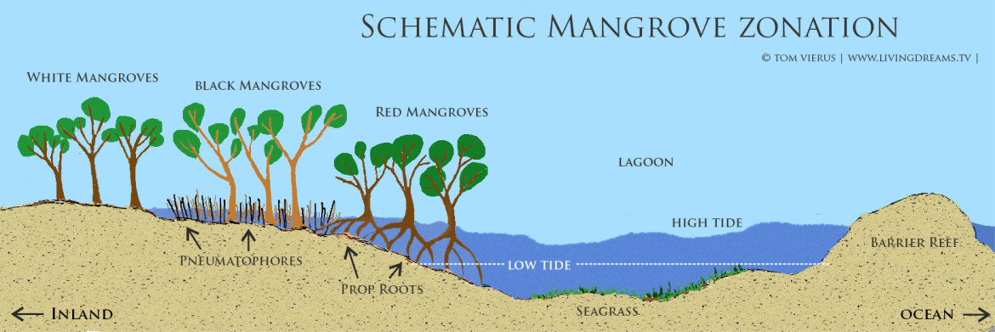
What are Mangroves?
3
One of the most important and productive ecosystems on the planet (Miththapala, 2008)
Found in the intertidal zone between sea and land, along sheltered and shallow watered coastlines
18 million hectares (Kathiresan, 2001) across 112 different countries and territories (Spalding, 1997)
Robust and highly adaptable (Alongi, 2008)
Large root systems:
Aerial stilt-like roots
Lateral roots extending sideways
Mitigate effects of powerful tidal waves
Carbon sequestration (Taillardat, 2018)
Mangrove Succession Diagram - Cayman Islands National Conservation Law Section 17
Notes:
Intertidal zone
Important ecosystems
Provide income sources
Robust and highly adaptable
Large root systems
Ability to capture and store atmospheric co2

Slide 4
Aims
4
Develop a remote sensing approach to classify mangrove species and assess their health
Achieve reasonable efficiencies and purities while using a minimum number of measurements
Maintain a high spectral resolution to ensure the measurement taking process is quick and easy
Notes:
Develop remote classification method
Use a minimum number of measurements
High spectral resolution

Slide 5
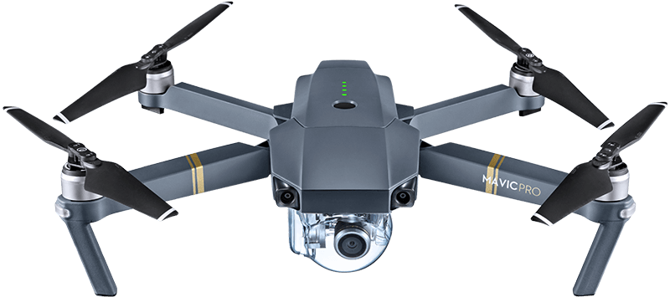

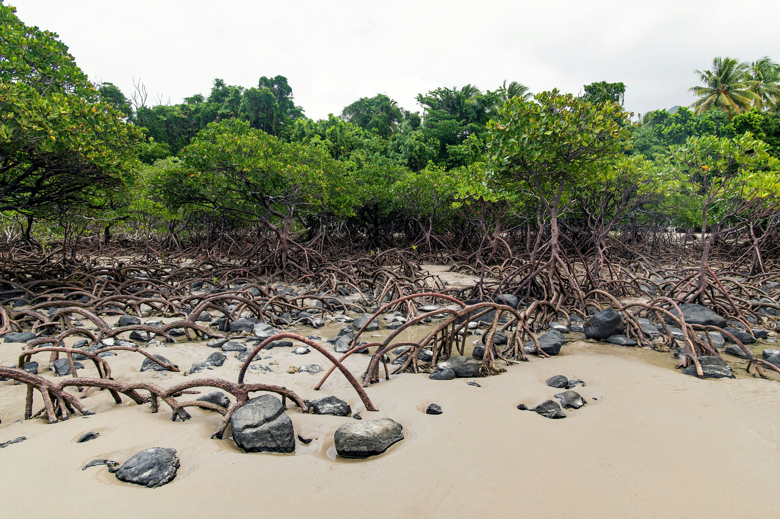
5
Reflectance Spectra
Drone takes measurements
Healthy
Stressed
Sunlight
Reflection from leaves
Data Processing
Red Mangroves
White Mangroves
Mangrove Forest
Black Mangroves
Notes:
Diagram of process
Use drone
Detect reflected light at specific wavelengths
Instantly classify species and health status

Slide 6
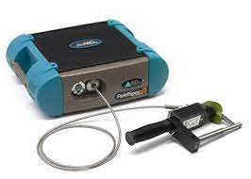
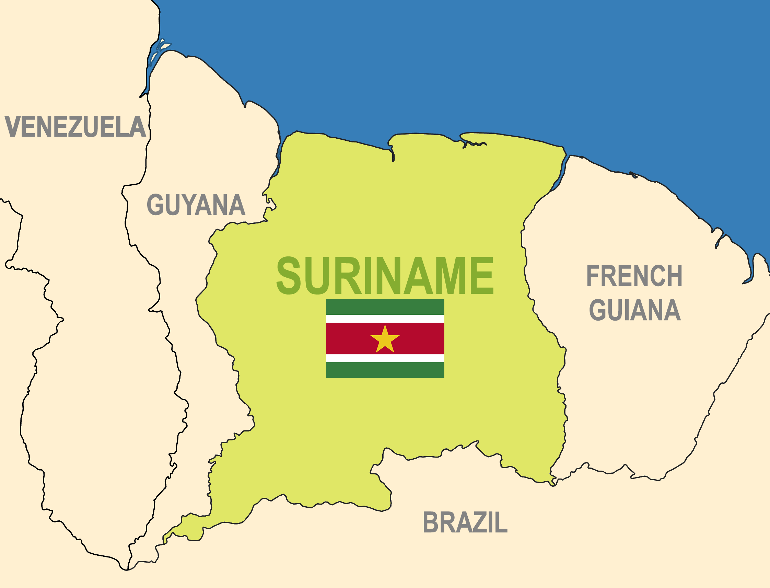
The Data
6
Reflectance spectra every nanometer from 350-2500 nm
798 mangroves across five locations:
250 Red (Rhizophora mangle)
218 White (Laguncularia racemosa)
330 Black (Avicennia germinans)
Manually collected from Suriname using an ASD FieldSpec 4 Spectrograph
Normalised to reference reflectance values from a Spectralon panel
Assumption: The dataset is representative of the entire mangrove population
ASD FieldSpec 4 – Analytik.co.uk
Map of Suriname with national flag
Notes:
Reflectance spectra for 798 mangroves using ASD FieldSpec 4 spectrograph
Would take a long time
Emphasises why remote UAV method would be a significant improvement on large scales
3 species
350-2500 nm with data every nm – 2151 points per spectrum
Normalised reflectance values relative to white spectralon panel to calibrate the values

Slide 7
7
Method – Statistical Approach
Plot Spectra
Data Cleansing
Variance and P-values
Data Binning
Direct Discrimination
Indirect Discrimination
Notes:
Roadmap for method
Signposts are main steps necessary

Slide 8
8
Plot Spectra
Normalised reflectance values across 2151 wavelengths between 350 – 2500 nm for each species
Notes:
Full spectra for the 798 mangroves in dataset split into the 3 species
250 red
218 white
330 black
Patterns similar with a few differences
Can't notice clear discrepancies by eye so a statistical approach is required

Slide 9

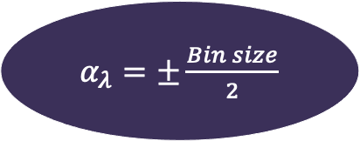
9
Data Binning
Wavelength Range (nm) | Bin Size | Uncertainty (± nm)
350 – 1051 | 3 | 1.5
1052 – 2101 | 10 | 5
2102 – 2485 | 12 | 6
2486 – 2500 | 15 | 7.5
$α_{λ}=±\frac{Bin size}{2}$
$$α_{Ref}=\frac{σ_{N−1}}{\sqrt{N}}$$
Number of data points per spectra reduced from 2151 to 372
Notes:
Resolution declines with increasing wavelength
Spectrograph manual – resolution 3 nm at 700nm and 10 nm at 1400/2100 nm
Chunked data using the trend that theres worse resolution at higher wavelenths
Read table
Averaged reflectance data within each bin and took standard error alpha ref to be the uncertainty on the reflectance in each bin
Central wavelength was taken to represent each bin
Wavelength uncertainty taken to be ±1/2 the bin size
Reduced the number of data points per spectrum but now had uncertainties making the data easier to interpret

Slide 10
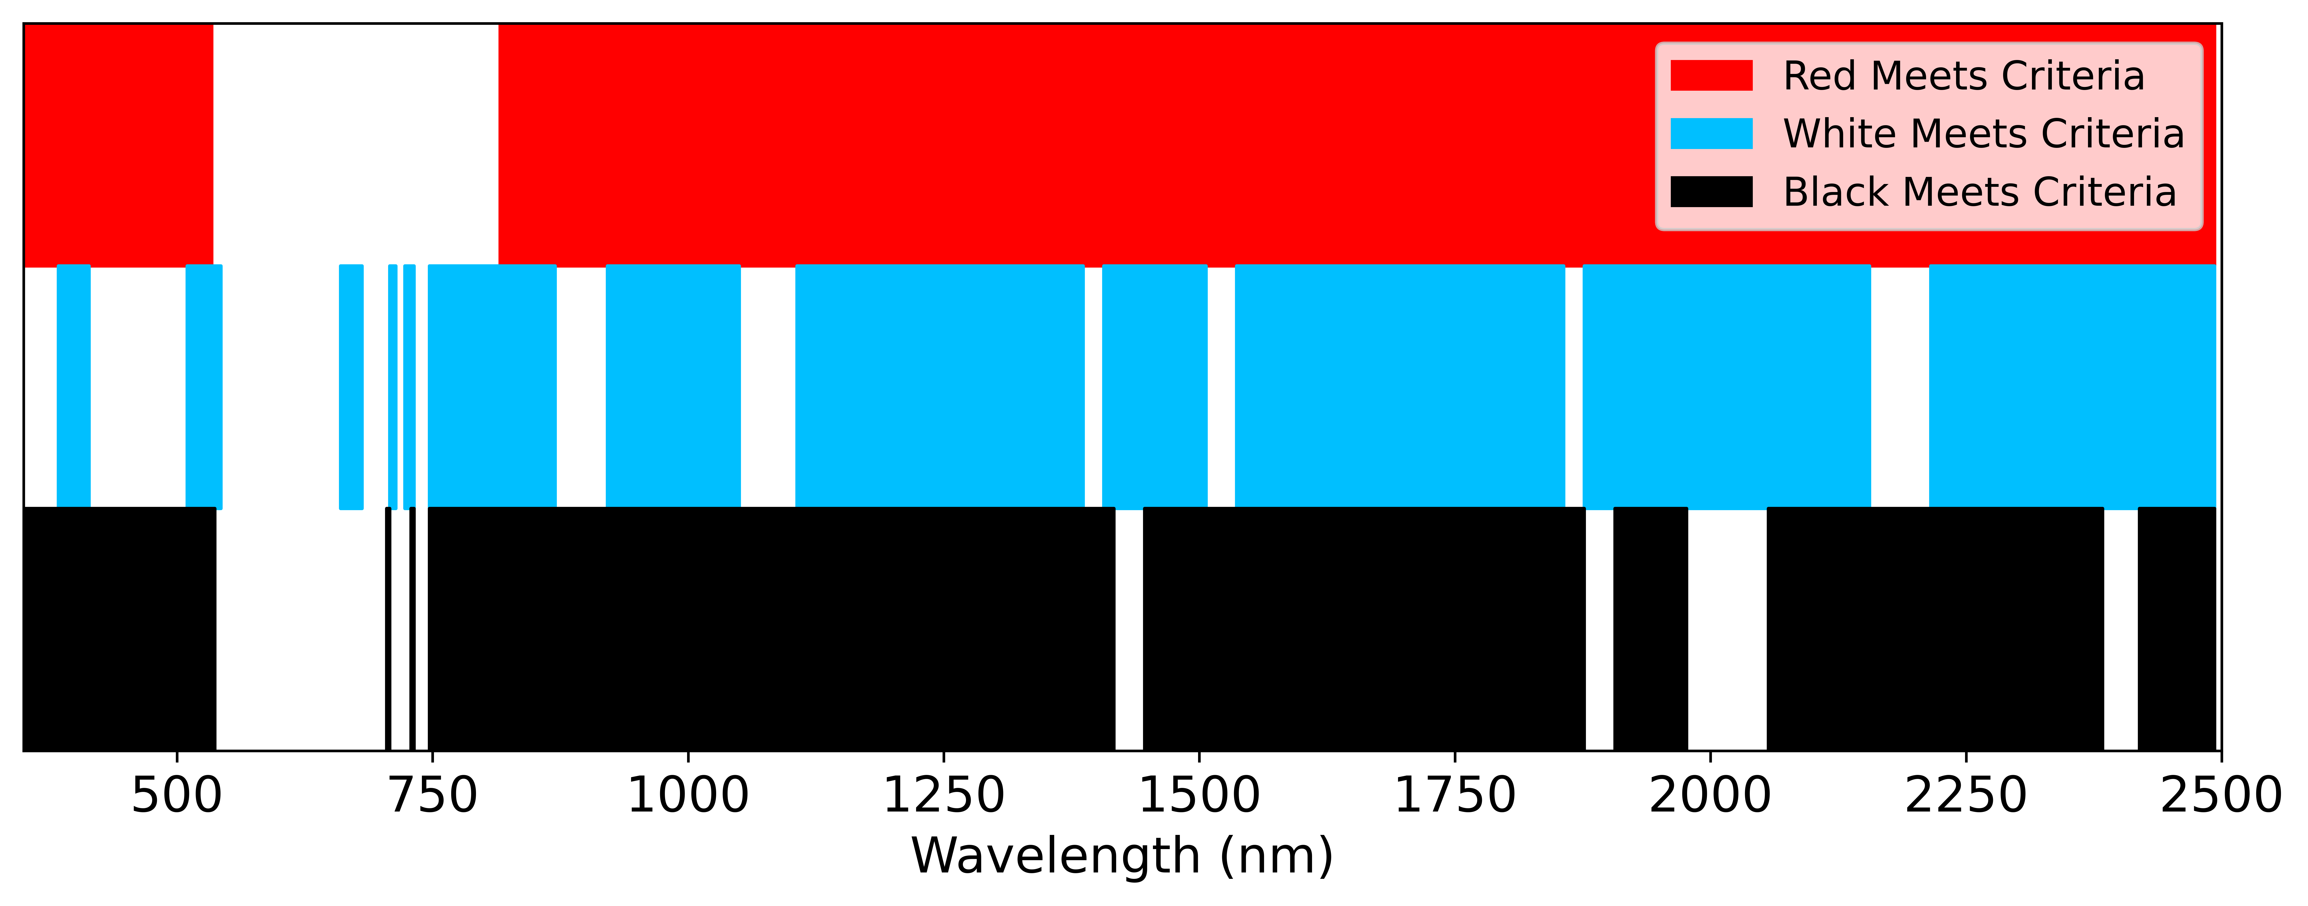
10
Variance and P-values
White
Red
Black
Desired P-values: p < 0.05
Desired Variance: σ² < 0.005
Notes:
Find wavelengths with potential to discriminate
Hypothesis that low variance insinuates consistent reflectance for that species
P-values calculated to infer if there was statistical significance
Independent t-test
5% level
Switch focus back to variances – large spike in red 4 x larger than that in white and black
Set criteria to cut this region out
Still lots of areas to investigate

Slide 11
11
Direct Discrimination
Suitable wavelengths specific to each species:
0 Red
1 Black
14 White
Average efficiency: 96%
Average purity: 31%
Notes:
Bins that met the p-value and variance criteria for just a single species
Set boundary defining each species as 2-sigma
Curves on central graph guide you
Green lines represent boundary for white in right graph
No clear separation
Good efficiencies so boundaries capture their own species
Bad purities so many other species also captured
Same if take combination for the white
Not suitable and needed different approach

Slide 12
12
Data Cleansing
250 Reds in sample
17 Reds cut out
233 Reds in sample
Notes:
Revisit bump in red variance
Red behaviour different in 500 – 750 range despite being similar for rest of spectrum
Plot 600 vs 651
White and black no higher than 0.25, red up to 0.6/0.7
Cut out reds about 0.3
Removed 17 reds – decreasing sample by 7%

Slide 13
13
Indirect Discrimination
Notes:
No bins where mean reflectance separated by 2 sigma
Indirect discrimination method developed – Venn diagram – up to 2 bins to define a species
Choose bins where species separated by the largest values relative to standard deviation
Distances from each species mean, to each other species mean as a fraction of the standard deviation of the species that the distance was being measured from
Mean of the moduli of fractional distances at each wavelength – plot on the right
Bottom plot shows bin with highest separation between the three species
Find bins with different central species
Spread species boundaries across multiple bins
Some species share a boundary

Slide 14
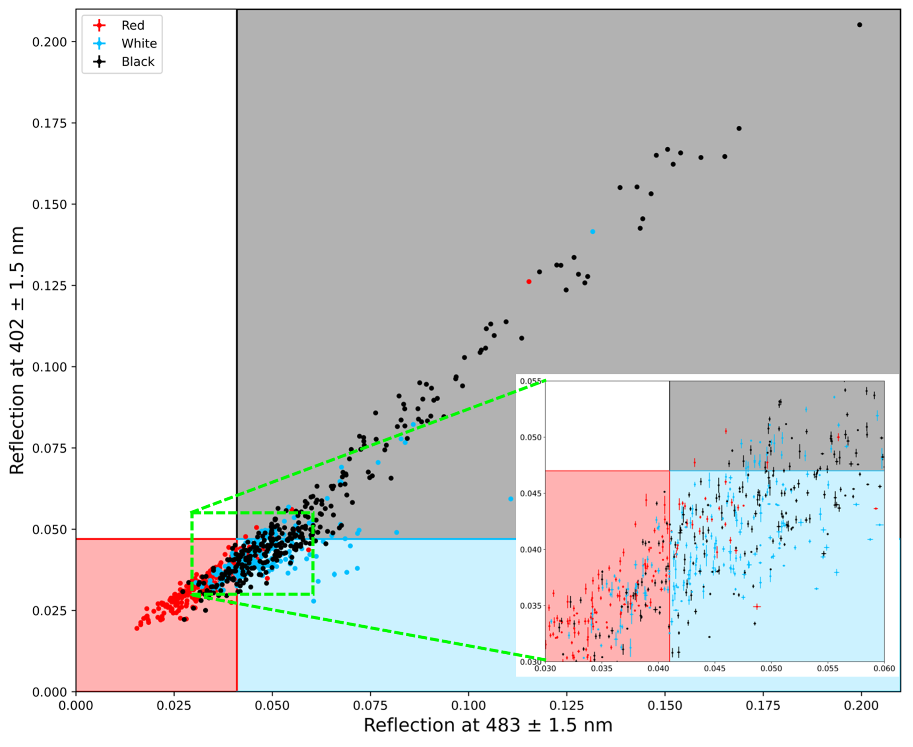
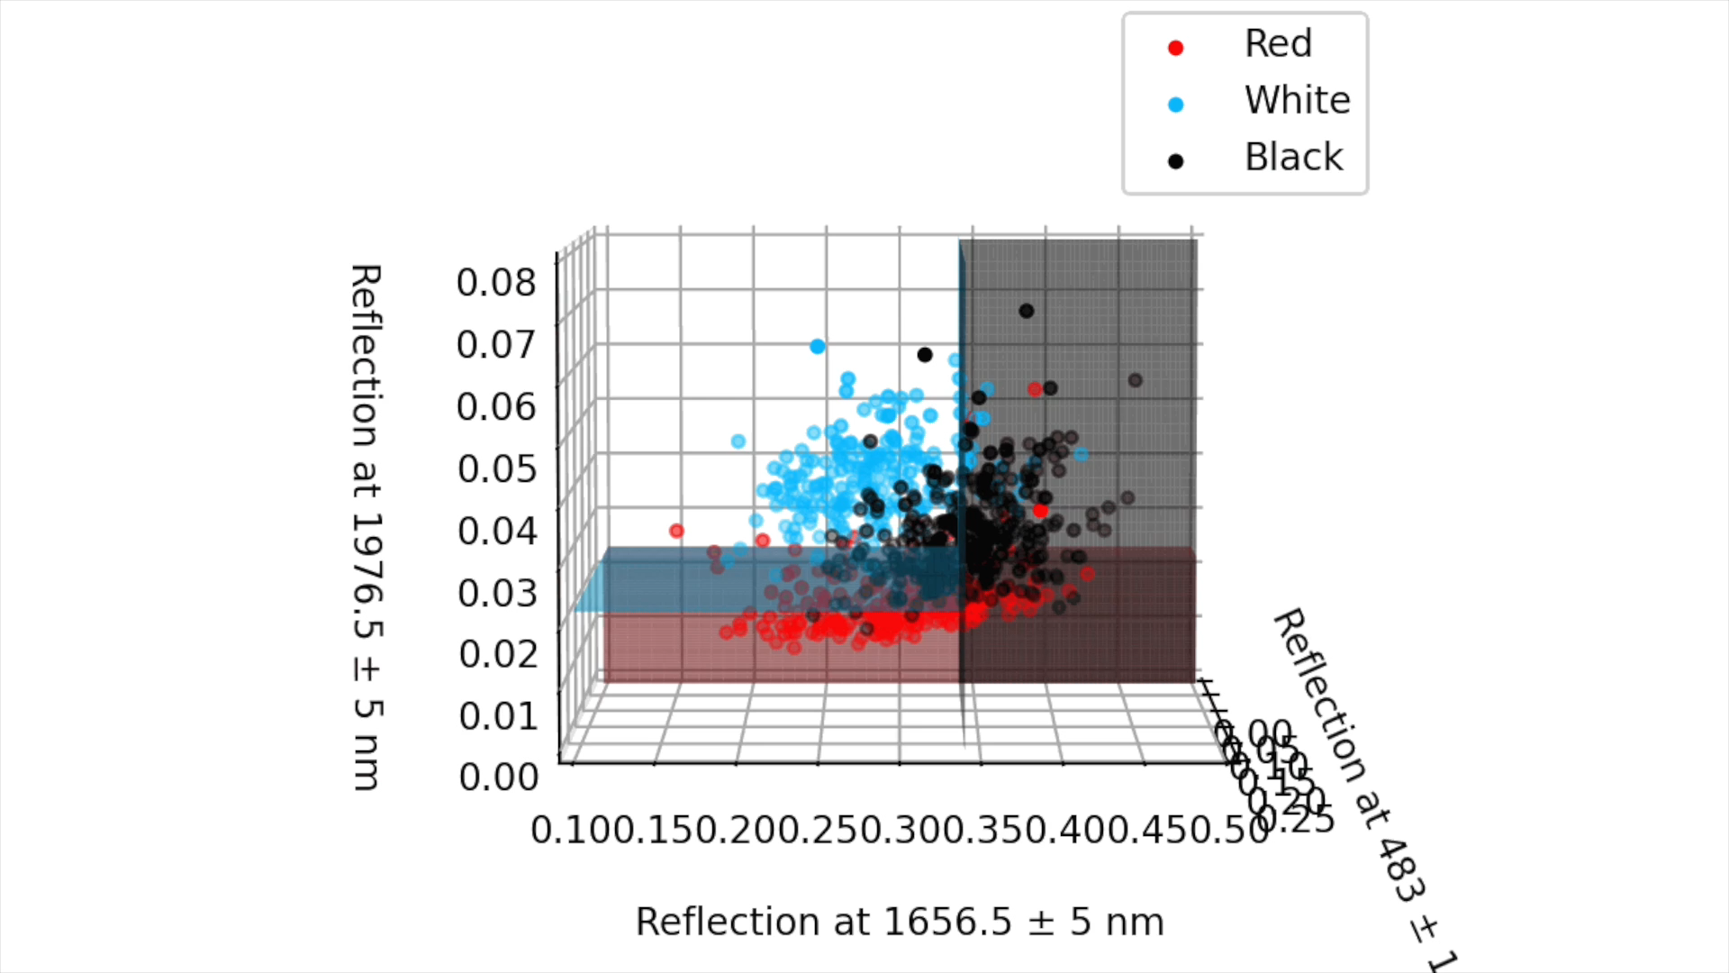
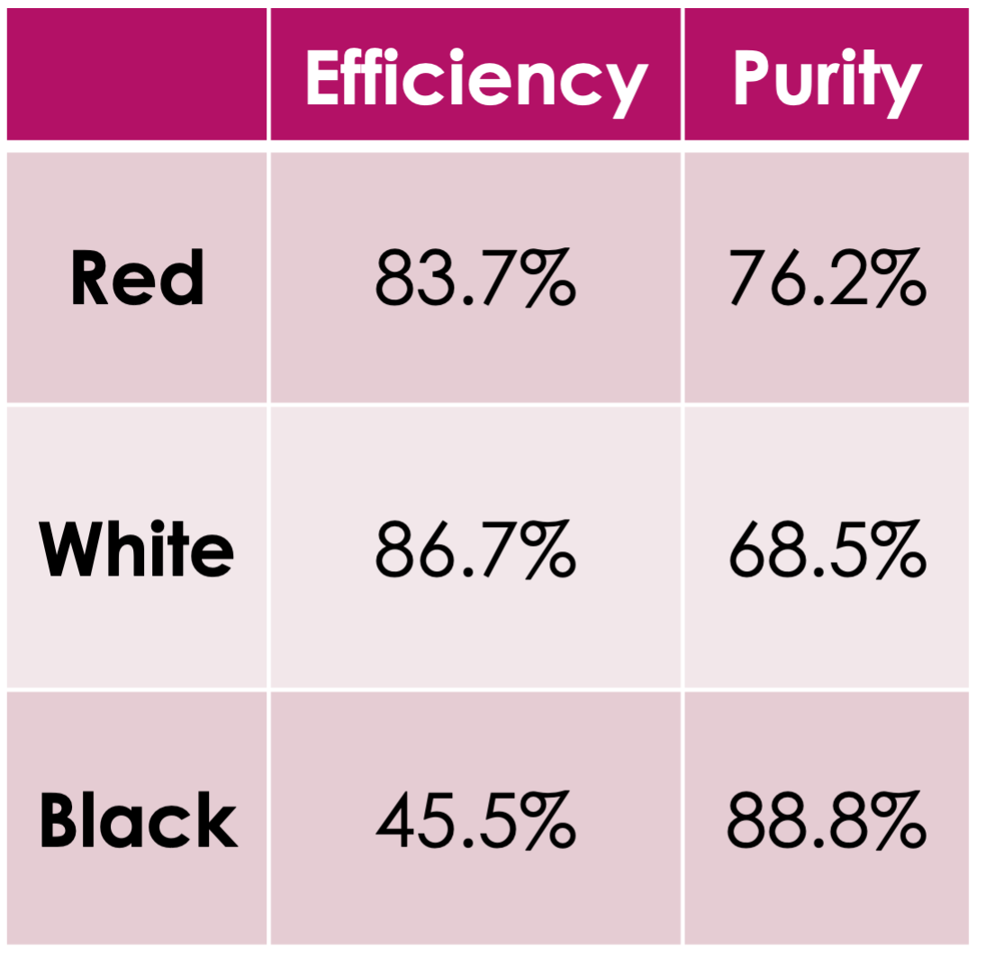


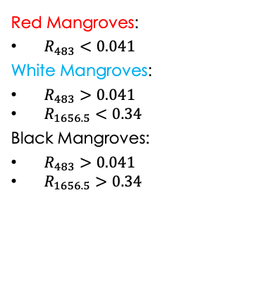
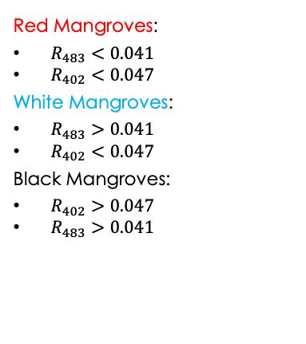
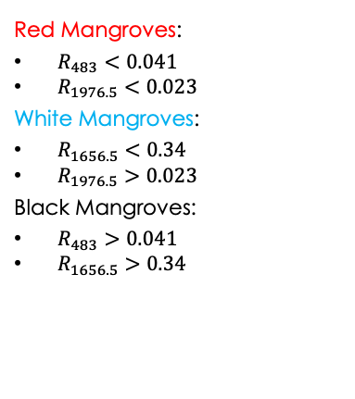
14
Results – Statistical Approach
Best Accuracy | Optical Only | Compromise
Red Mangroves:
$R_{483}<0.041$
$R_{1976.5}<0.023$
White Mangroves:
$R_{1656.5}<0.34$
$R_{1976.5}>0.023$
Black Mangroves:
$R_{483}>0.041$
$R_{1656.5}>0.34$
Red Mangroves:
$R_{483}<0.041$
$R_{402}<0.047$
White Mangroves:
$R_{483}>0.041$
$R_{402}<0.047$
Black Mangroves:
$R_{402}>0.047$
$R_{483}>0.041$
Red Mangroves:
$R_{483}<0.041$
White Mangroves:
$R_{483}>0.041$
$R_{1656.5}<0.34$
Black Mangroves:
$R_{483}>0.041$
$R_{1656.5}>0.34$
Notes:
Practicality of the results
NGOs – cost isn’t an issue – set of results which gave the best statistical performance
Planes separating each species
Red mangrove reflectance < 0.041 in 483 and < 0.023 in 1976.5nm bin and so on
Reasonable purities - twice as good as in the direct discrimination case
Drop in efficiencies – large in black
2 IR bins – tens of thousands
Optical only – 483 nm and 402 nm
Difficult to have different central species
Zoomed in section shows boundary up close
Not too bad compared to best possible
Technology is developing – bridge the gap
New IR camera
Maintain good red and black and get mid point in white
Large % of misclassifications bring into question scalability

Slide 15

15
Machine Learning
LDA
Gradient Boosting
Neural Network
Decision Trees
Random Forest
Notes:
Humans limited
Use ML to improve results
Analyse a much larger parameter space

Slide 16
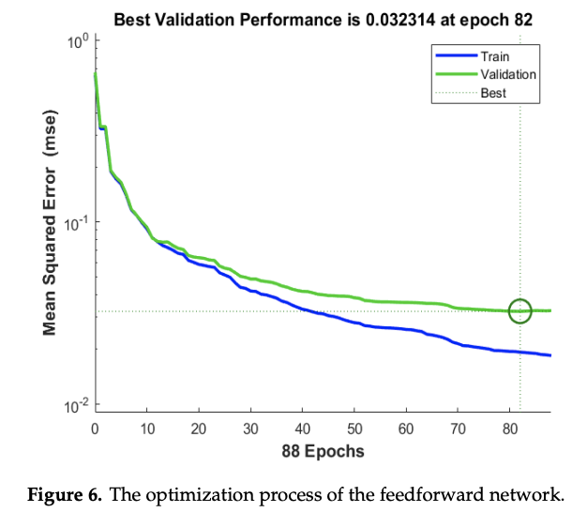
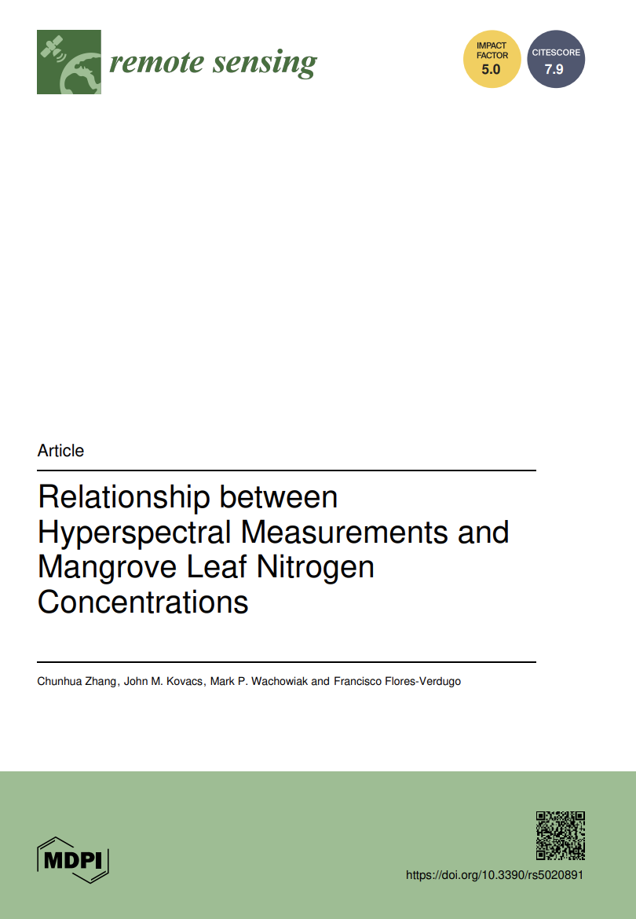
16
Why Neural Networks?
Highly adaptable and flexible
Many literature comparisons
Nezami et al
Final loss = 0.03
Inputs
Hidden Layer
Outputs
Zhang et al
ANN separates between Red and Black mangroves
Future work – improve determination of the hyperparameter values
Input
Outputs
Hidden Layers
Notes:
Highly adaptable and flexible
Useful as I’m trying to find different numbers of bins and different combinations which give the best results
Papers which use similar NNs so I can compare results and see if I can improve

Slide 17
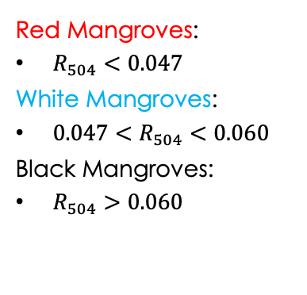
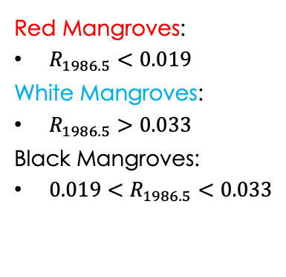
17
Results – Neural Network
Best Accuracy | Optical
Learning rate = 0.01
Input = 1
3 Hidden Layers
1 Neuron
1 Neuron
8 Neurons
Output = 3
Accuracy = 80%
Learning rate = 0.0001
Input = 1
3 Hidden Layers
4 Neurons
Output = 3
Accuracy = 58%
Red Mangroves:
$R_{1986.5}<0.019$
White Mangroves:
$R_{1986.5}>0.033$
Black Mangroves:
$0.019<R_{1986.5}<0.033$
 | Efficiency | Purity
Red | 76.0% | 84.8%
White | 84.9% | 68.3%
Black | 64.8% | 70.6%
Red Mangroves:
$R_{504}<0.047$
White Mangroves:
${0.047<R}_{504}<0.060$
Black Mangroves:
$R_{504}>0.060$
 | Efficiency | Purity
Red | 67.6% | 72.8%
White | 41.3% | 40.5%
Black | 63.0% | 60.5%
Notes:
Flexible NN which looped through 5 LRs, could have 1,2 or 3 hidden layers each with 1,2,4 or 8 neurons
Select best combination
Best accuracy was in 1986.5 nm – 80%
Read boundaries
Decent results all round – one average better than the best statistical approach and we’ve only used a single bin
Faster process
Best optical was 504nm – 57% accuracy – poor at classifying the different species
Multiple in puts may be necessary to achieve good results
Further supported by the high final loss
Highligh power of ML

Slide 18

Future Work
18
Multiple-Input Neural Network
Pathogen Identification
Improved accuracy and lower loss
Additional use-case to the model
Higher drone flight capabilities
Faster coverage of mangrove forests
More opportunity to explore the optical only regime
Can the wavelengths line up to create a cost-effective and cohesive model?
Would allow complete maintenance of the three mangrove species
Notes:
A few avenues I’d like to explore
Play around with the number of inputs and outputs of NN
Test situations like having many optical cameras to try to achieve best accuracies at the most cost-effective price while maintaining high spectral resolution
Do same process for health data
Extend the usefulness and reinforce the validity of my model by verifying approach with different data
Explore if I could get both species classification and pathogen identification through the same wavelengths
Produce a complete and cohesive method of maintaining mangroves

Slide 19
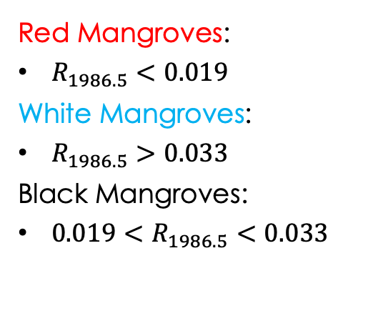
Conclusions and Summary
19
Develop a remote sensing approach to classify mangrove species and assess their health
Achieve reasonable efficiencies and purities while using a minimum number of measurements
Maintain a high spectral resolution to ensure the measurement taking process is quick and easy
Neural Networks provided better or comparable results using less measurements
 | Efficiency | Purity
Red | 76.0% | 84.8%
White | 84.9% | 68.3%
Black | 64.8% | 70.6%
Red Mangroves:
$R_{1986.5}<0.019$
White Mangroves:
$R_{1986.5}>0.033$
Black Mangroves:
$0.019<R_{1986.5}<0.033$
Notes:
All 3 aims achieved
High spectral resolution regardless of the budget of the user
Need to consider a method of quantifying the allowed error in the ambient light
Rigid boundaries so since measurement taken at different times of day will have different light intensities, we may get different results
NN provided better or comparable results using less measurements
Best results achieved so far by NN can be seen on slide
Next steps – look to improve results by having multiple inputs
Try to create a more robust boundary for each species
So thanks for listening and I’d be happy to answer any questions

Slide 20
Appendix I: Where are the Missing Mangroves?
20
 | Statistical Approach |  |  | Neural Network
 | Best Possible | Optical Only | Compromise | Best Possible | Optical
Red | 10 – White 5 – Black 23 - Uncategorised | 25 - White 6 - Black | 26 – White 5 - Black | 4 – White 56 – Black | 49 – White 32 – Black
White | 7 – Red 14 – Black 8 - Uncategorised | 46 - Red 41 - Black | 46 – Red 14 - Black | 0 – Red 33 – Black | 24 – Red 104 – Black
Black | 54 – Red 77 – White 49 - Uncategorised | 57 - Red 115 - White | 57 – Red 123 - White | 34 – Red 82 – White | 39 – Red 83 – White

Slide 21
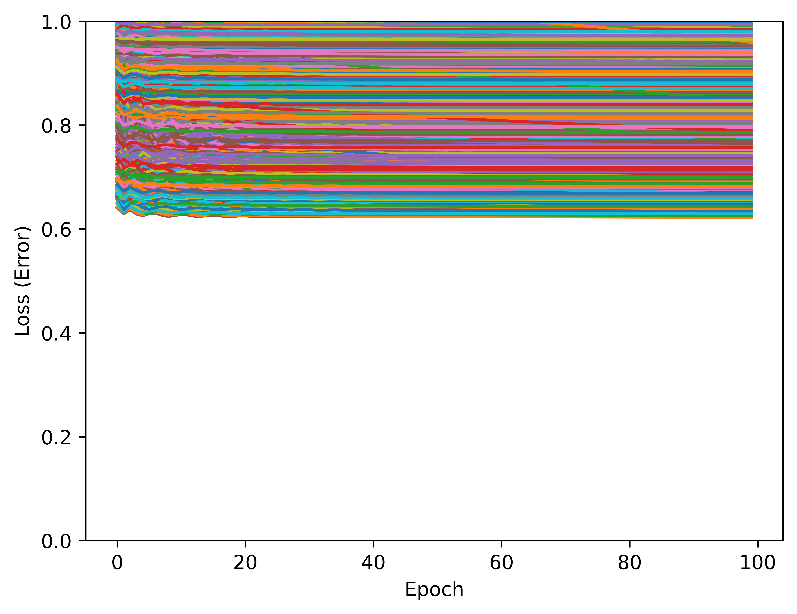
Appendix II: Hyperparameter Optimisation
21

Slide 22
Appendix III: Assumptions – Ambient Light
22
12 pm
2 pm
Light intensity dependent on:
Sun angle (time of day)
Atmospheric changes (Absorption)
*Diagram not to scale

